Slide 1
Topic 1: Personal Photo Album Mining
Vo, Doan Quoc Sy (Steven) – 150201133@svuca.edu

Slide 2
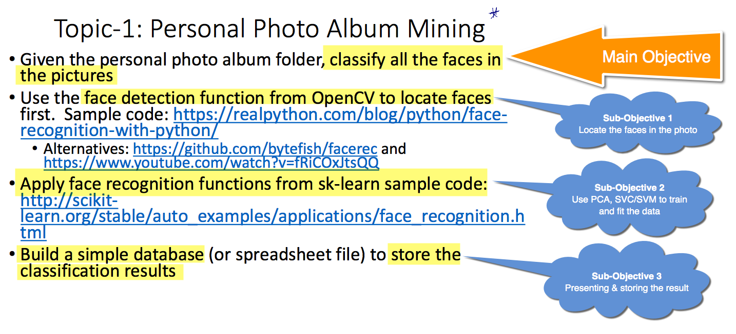

Slide 3
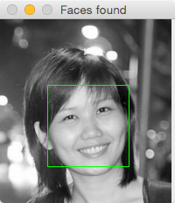
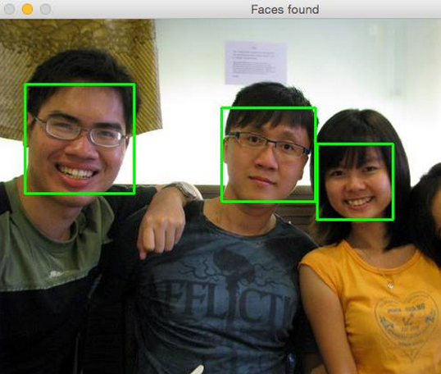
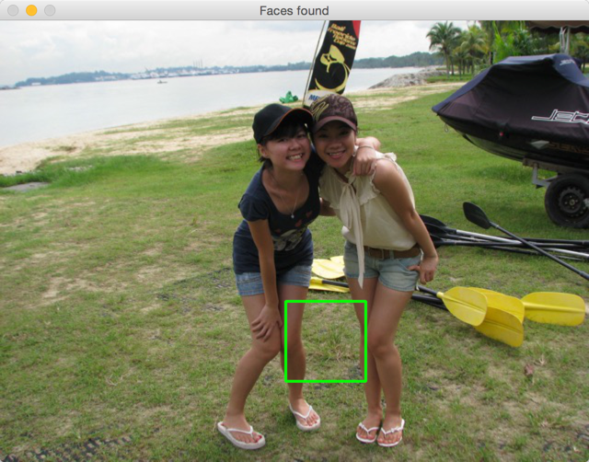
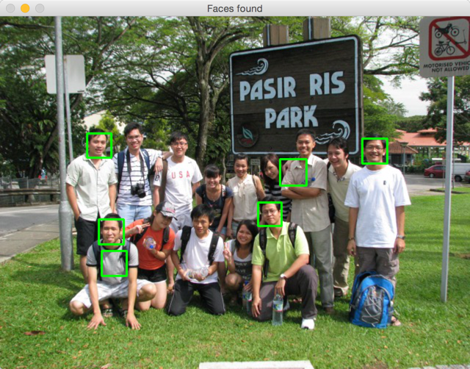
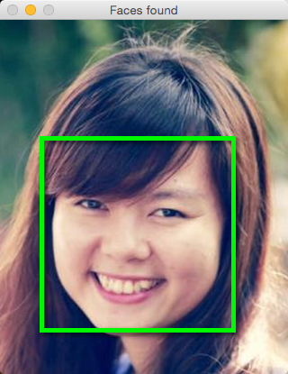
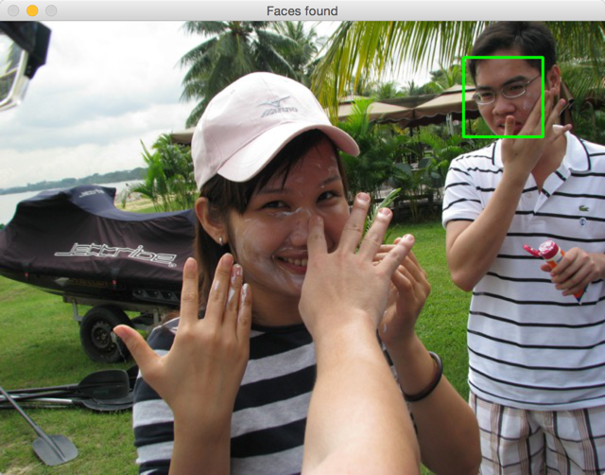
Obj-1: Locate The Face
Locate the faces in photos – using OpenCV

Slide 4
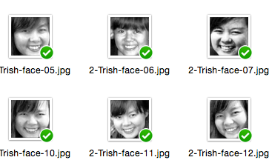
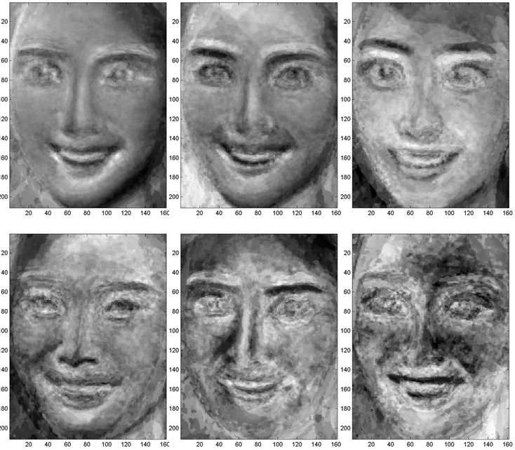
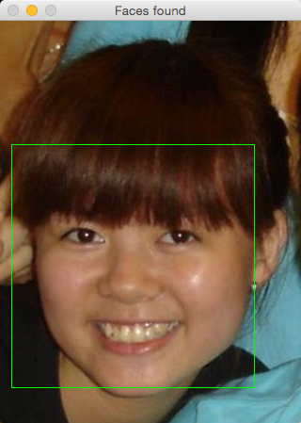
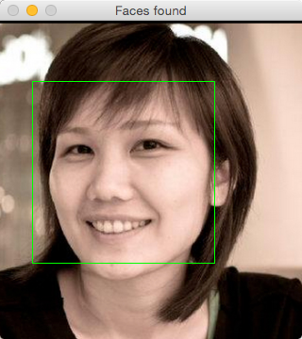
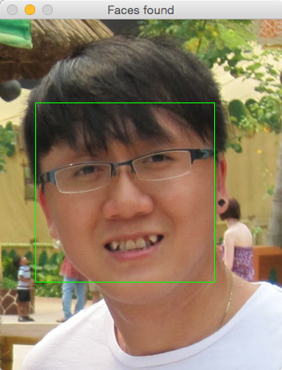
Obj2 – Recognize the face
The program should go through these 5 steps before it can recognize a face properly
Training Data
Test Data
PCA
Training
Validation
Training Data
Eigenfaces
Trish
Tracy
Steven

Slide 5
Obj3 – Presenting and Storing Data
The classification result will be stored into a database, which can be implemented by
File system (txt, dat, etc.)
Spreadsheet (xlsx, csv, etc.)
“Real-world” database system (mongo, redis, mysql, etc.)

Slide 6
Project Repository
Student offers: https://education.github.com/pack/offers

Slide 7
Progress Report
Week 1 – Completed features
Using OpenCV to detect face
Crop face and pre-process faces
Preparing database for training & testing
Simple face detection including PCA compression (into eigenfaces), training, validation of model
Week 2 – Completed features
Generate more training data by tools introduction
Face Flipping: to produce 2 images of the same person (for better recognition of both sides)
Ability to click on the square box in OpenCV to choose which face can be extracted (since OpenCV is not always correct)
Ability to load and store the progress of face extraction & review so we can resume later with newer images
Implement GridSearchCV, kernel RBF to find best settings in multiple C and Gamma values.
Add auto-scaling when displaying & processing large images.
Printing Confusion Matrix in result (using SKLearn)
Printing Classification Report in result (using SKLearn)
Week 3 – Completed features
Store and Load trained model using Pickle
TODO
Applying adaboost, either with SVM or other classifier and compare the result. [experiment]
Build some UI function to show "Name" directly on the face in TEST photo. [fancy feature]
Load and store eigenfaces so the recognition can be performed in real-time
Find a way to deal with face angle (when it’s not straight)

Slide 8
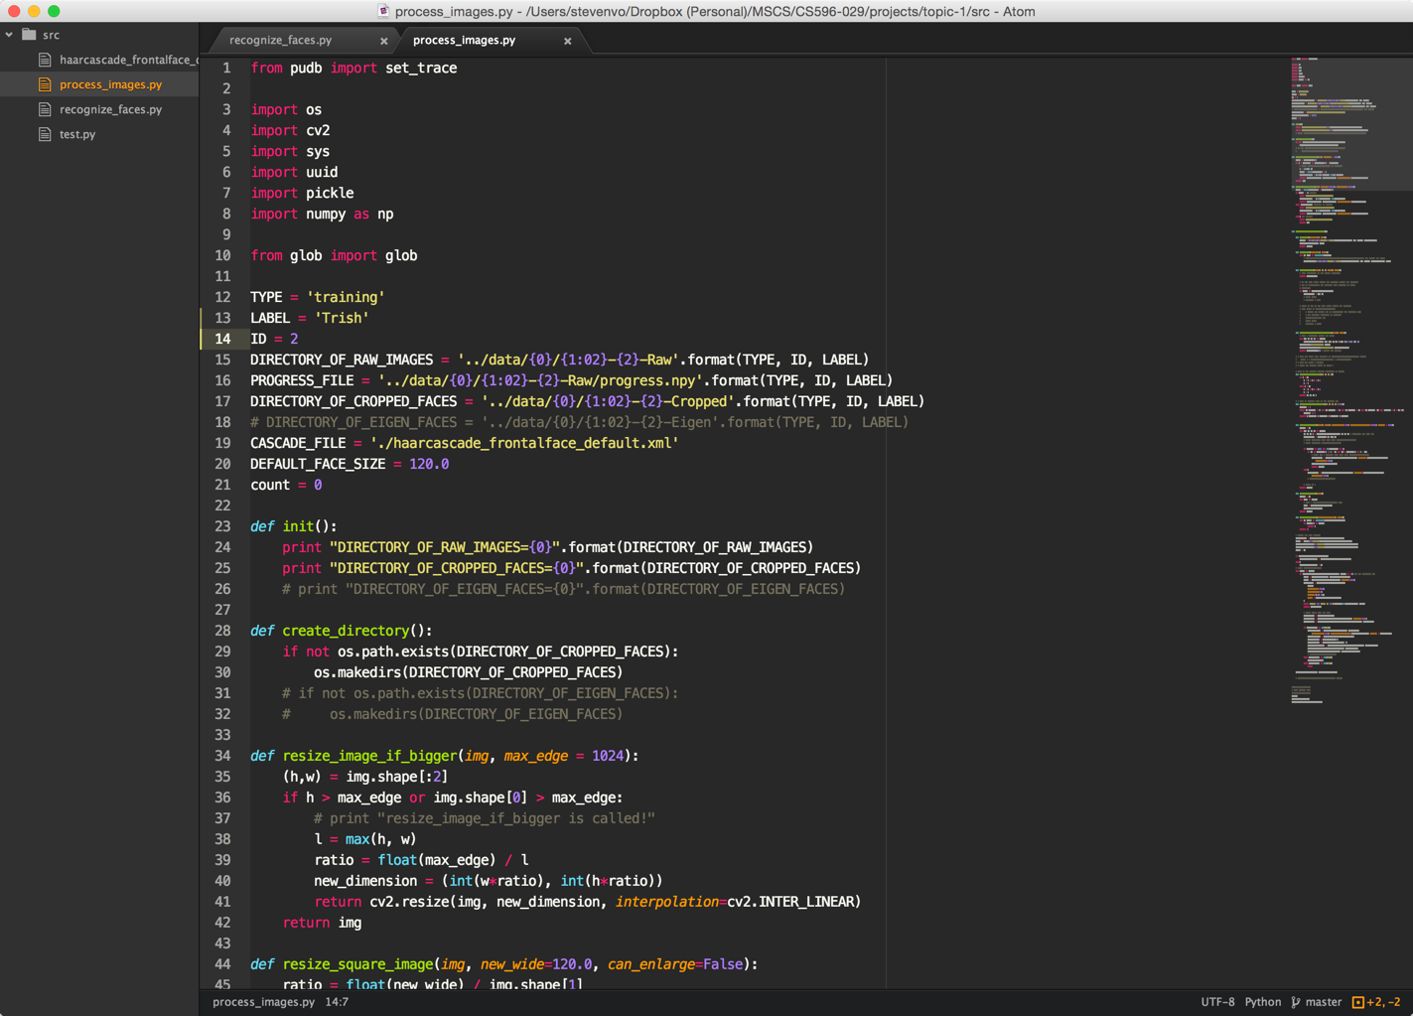
DEMONSTRATION

Slide 9
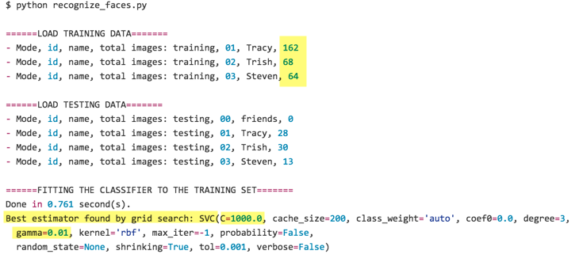
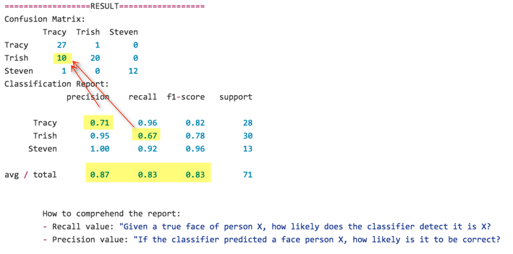
Progress Report
Result by week 2
The result improved significantly since implementing GridSearch

Slide 10
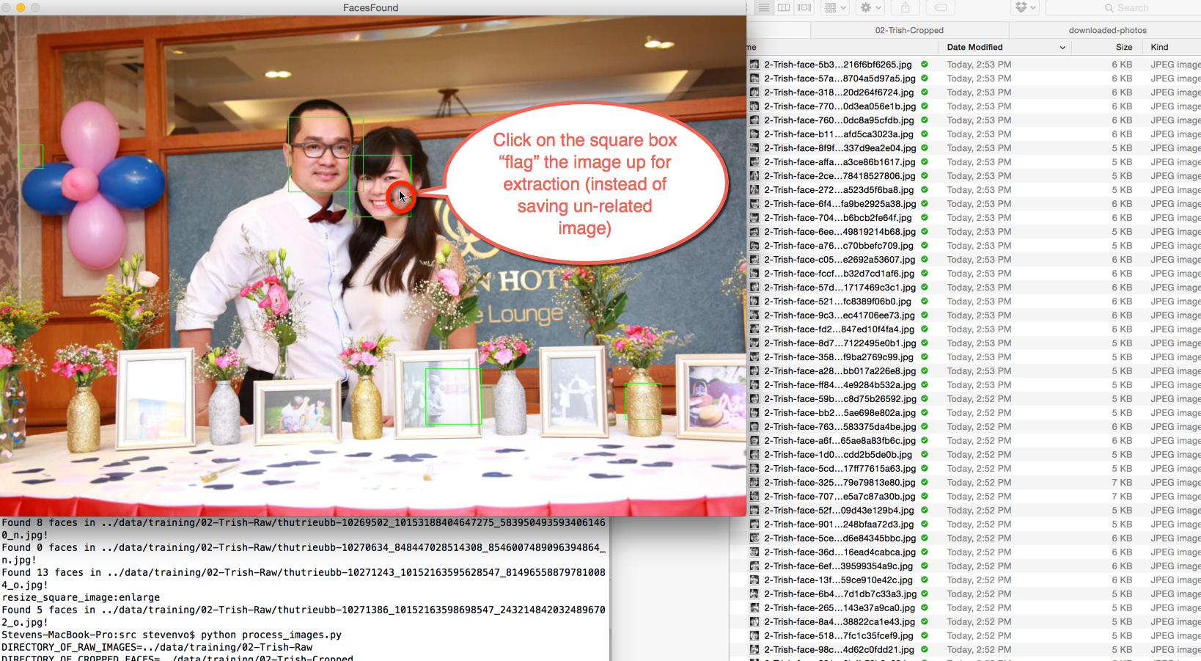
Click to Save

Slide 11
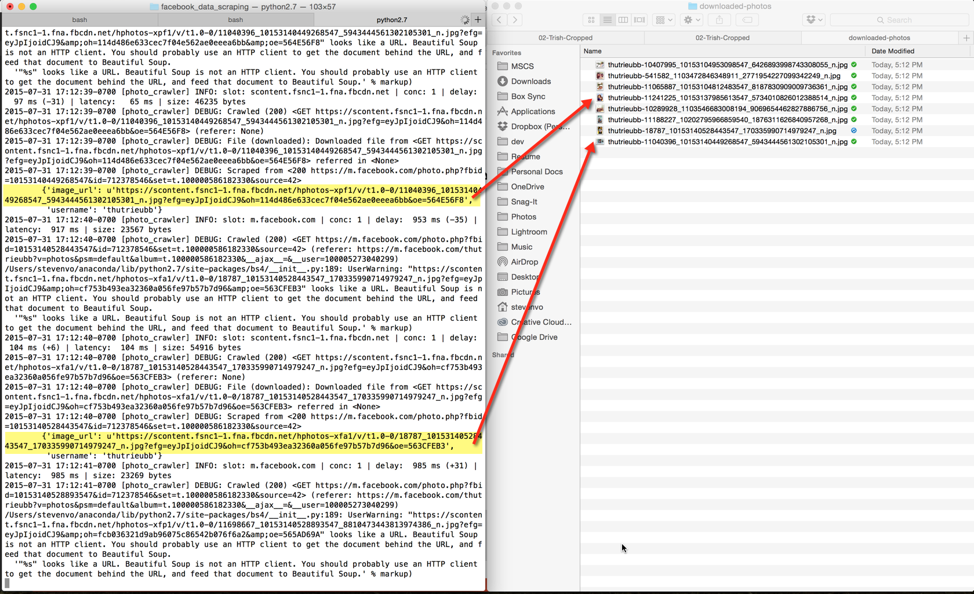
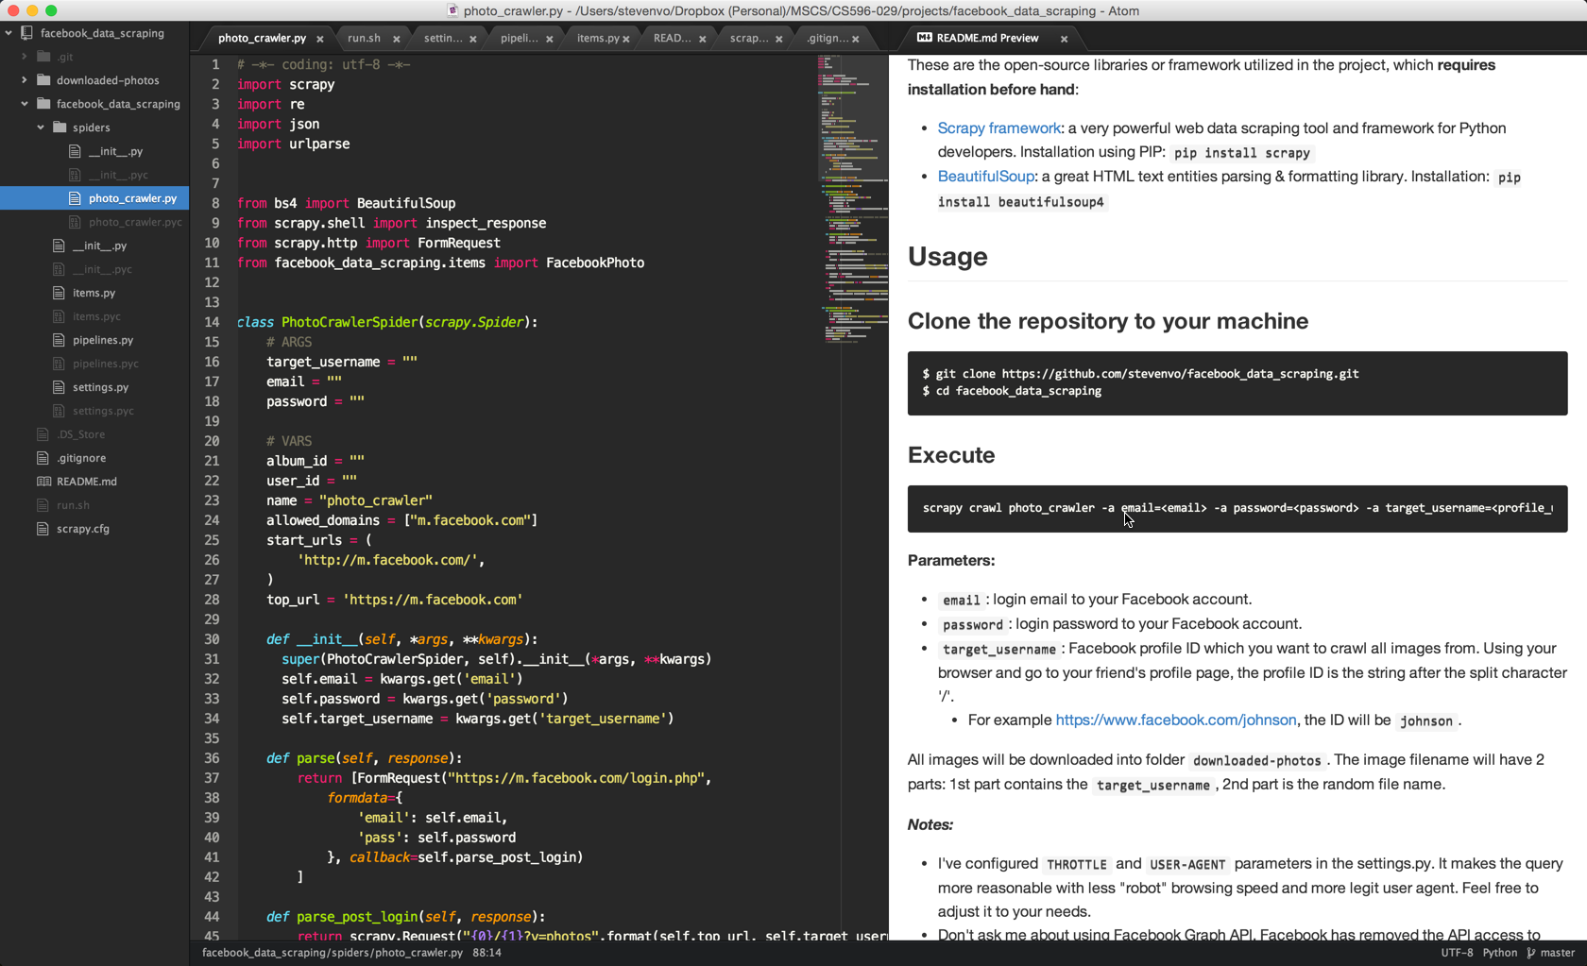
Facebook Image Crawler
https://github.com/stevenvo/facebook_data_scraping

